Slide 1

Project SRS Presentation
Project ID: PWE 2011 BIT - 05
Communicable Disease and Analytical System

Slide 2
Team members
Project Manager:
BIT-09C1-059 - L.K.N.P Gunaskara.
Supportive Staff:
BIT-08-C2-159 - P. K Weerasekara.
    BIT09-C1-072 - Y.W Panditha.
    BIT09-C1-085 - N.L Hewawilladdara
    BIT09-C1-100 - B.T.G Mendis.
Supervisor :
Mr. Yasas Jayaweera

Slide 3
Content…
BIT09C1-072 Communicable Disease and Analytical System 6/05/2011

Slide 4
What is Our System?
BIT09C1-072 Communicable Disease and Analytical System 6/05/2011

Slide 5
What are the presently available system?
BIT09C1-072 Communicable Disease and Analytical System 6/05/2011

Slide 6
What is the Research problem?
BIT09C1-072 Communicable Disease and Analytical System 6/05/2011

Slide 7
Introduction
BIT09C1-072 Communicable Disease and Analytical System 6/05/2011

Slide 8
The purpose of this presentation is to provide a detailed description of the functionality and technology of the Communicable Disease and Analytical System
BIT09C1-072 Communicable Disease and Analytical System 6/05/2011

Slide 9
Overall Description
BIT09C1-072 Communicable Disease and Analytical System 6/05/2011

Slide 10
What is Epidemiology?
Epidemiology is the study of patterns of health and illness and associated factors at the population level.
BIT09C1-072 Communicable Disease and Analytical System 6/05/2011

Slide 11
BIT09C1-072 Communicable Disease and Analytical System 6/05/2011

Slide 12
BIT09C1-072 Communicable Disease and Analytical System 6/05/2011

Slide 13
SYSTEM INTERFACES
BIT09C2-159 Communicable Disease and Analytical System 6/05/2011

Slide 14
The System requires a Windows XP operating system. Windows XP operating system provides an API to execute user application.
BIT09C2-159 Communicable Disease and Analytical System 6/05/2011

Slide 15
User interfaces
The system will be developed with a Graphical User Interface to user for interact with the application
BIT09C2-159 Communicable Disease and Analytical System 6/05/2011

Slide 16
Login Page
BIT09C2-159 Communicable Disease and Analytical System 6/05/2011

Slide 17
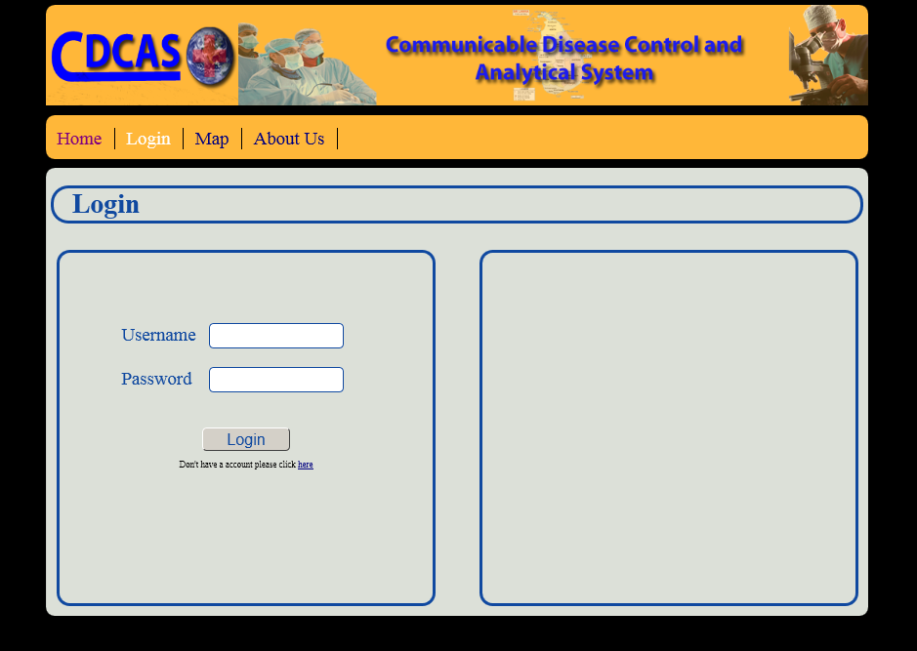

Slide 18
Register Page
BIT09C2-159 Communicable Disease and Analytical System 6/05/2011

Slide 19
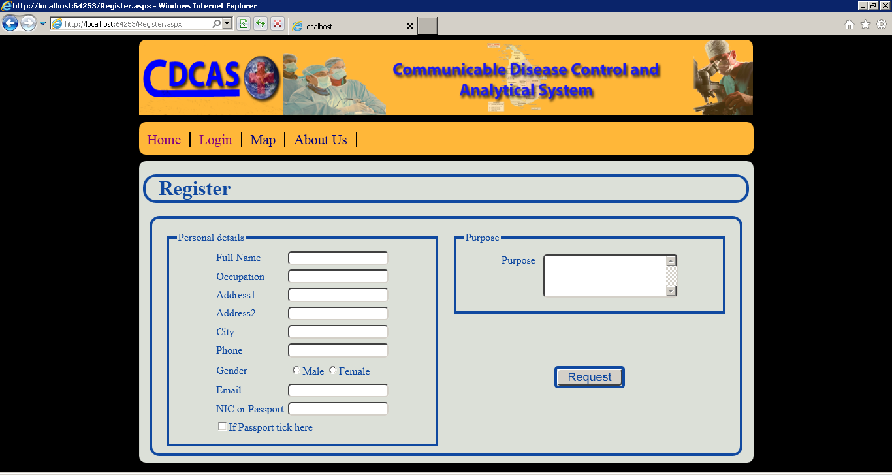

Slide 20

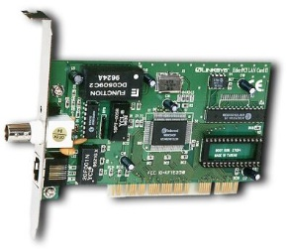
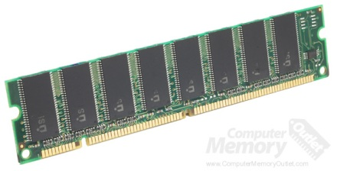
Hardware interfaces
Multi core processor
Server grade Network Interface Card
More than 4 GB memory
BIT09C1-100 Communicable Disease and Analytical System 6/05/2011

Slide 21



Software interfaces
Application:
ASP . Net
JDK 1.6
Database:
Microsoft SQL Server 2008.
Web Server:
IIS
Apache Tomcat
BIT09C1-100 Communicable Disease and Analytical System 6/05/2011

Slide 22


Communication interfaces
Dialup Modem of 52 kbps
Broadband Internet
Dialup or Broadband Connection with an Internet Provider
BIT09C1-100 Communicable Disease and Analytical System 6/05/2011

Slide 23
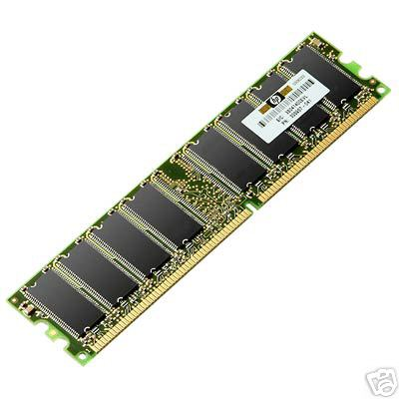
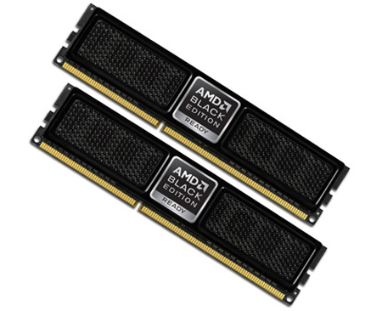
Memory constraints
More than 4MB of RAM.
12MB of storage space.
BIT09C1-100 Communicable Disease and Analytical System 6/05/2011

Slide 24
Operations
The system requires special data feeding. User should arrange daily data according to a given excel sheet and should use functions given in that excel sheet to upload data.
Integration with GIS database is unattended process this runs every night at 11.00 pm.
SMS generation is unattended process this runs every night at 11.00 pm.
BIT09C1-100 Communicable Disease and Analytical System 6/05/2011

Slide 25
Use Case Diagram.
BIT09C1-100 Communicable Disease and Analytical System 6/05/2011

Slide 26
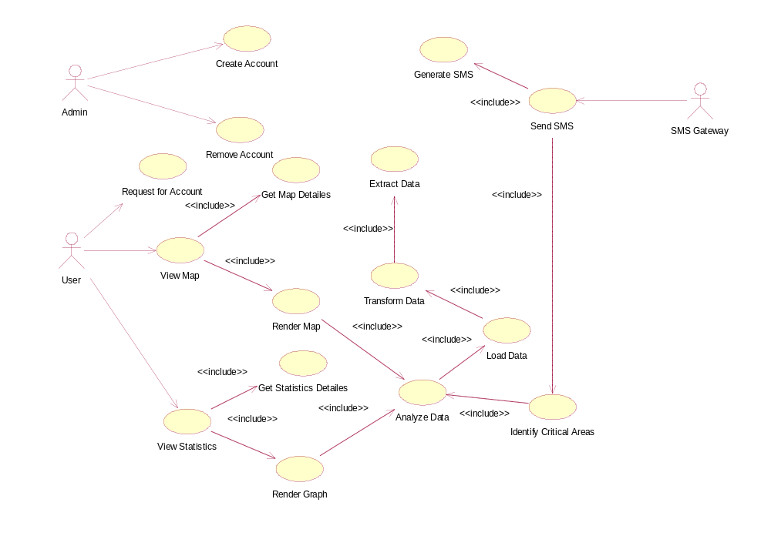
BIT09C1-100 Communicable Disease and Analytical System 6/05/2011

Slide 27
Performance Requirements
BIT09C1-085 Communicable Disease and Analytical System 6/05/2011

Slide 28
Must not use all the processing power of the computer.
Should not take long time to load the system.
The system is required to support to retrieve information with sufficient speed.
Used memory must be released after when they are not being used
BIT09C1-085 Communicable Disease and Analytical System 6/05/2011

Slide 29
Designing Constraints
BIT09C1-085 Communicable Disease and Analytical System 6/05/2011

Slide 30
User interface should make simple as possible
White space should be used wisely to increase the readability.
User interface final size should not exceed 657KB.
Since project addressing a real world problem object oriented approach is used. Because of that core language would be an object oriented language
BIT09C1-085 Communicable Disease and Analytical System 6/05/2011

Slide 31
Software System Attributes
BIT09C1-085 Communicable Disease and Analytical System 6/05/2011

Slide 32
Reliability requirements
    Input data entered by a user must not be mixed with the data of other users.
    System design should include the fail safe procedures which handles the possible exceptions in the systems flow of processes
BIT09C1-085 Communicable Disease and Analytical System 6/05/2011

Slide 33
Availability requirements
System contains many unattended scheduled processes so for smooth operation database should be 24/7 online.
Web application should be online all the time and can only be stopped for critical maintenance.
BIT09C1-085 Communicable Disease and Analytical System 6/05/2011

Slide 34
Security requirements
The stored data cannot be able to access by other application such as viruses.
Ensuring security and access control to sensitive data – industrial standard security procedures and access control should be implemented to control the availability of sensitive data to users.
BIT09C1-085 Communicable Disease and Analytical System 6/05/2011

Slide 35
Maintainability requirements
Server administrator should be able to maintain the application server and database. A client application will be provided with the system to do that
BIT09C1-085 Communicable Disease and Analytical System 6/05/2011

Slide 36
Other requirements
      Quality requirements
The GUI must not be very complex used in the system.
Internal exceptions and errors should be handled internally and showing them to in a non-technical manner to be understandable by the general user.
The system should not make the users angry, depressed and terrified when using it.
BIT09C1-085 Communicable Disease and Analytical System 6/05/2011

Slide 37
2.Safety Requirements
There should be a scheduled task to take backup of database periodically
Logger should be included to log all events occurred in run time
BIT09C1-085 Communicable Disease and Analytical System 6/05/2011

Slide 38
References
BIT09C1-085 Communicable Disease and Analytical System 6/05/2011

Slide 39
Health Programme:: Epidemic Control :: ISDP :: Objectives”, objectives of epidemic disease, 24 Feb 2011 [Online],Available:http://www.gujhealth.gov.in/health_programmes/epidemic/idsp_obj.htm,[Accessed:26 Feb 2011].
“Epidemic – Wikipedia, the free encyclopedia”, What is a Epidemic disease, 23 Jan 2011[online],Available:http://en.wikipedia.org/wiki/Epidemic , [Accessed: 26 Feb 2011].
“What is a Communicable Disease?”,communicable diseases, 11 February 2011 [online],Available:http://www.wisegeek.com/what-is-a-communicable-disease.htm,[Accessed: 26 Feb 2011].
“Communicable Diseases” , communicable diseases,22 February 2011[online],Available:http://www.whosrilanka.org/EN/Section31_81.htm, [Accessed: 26 Feb 2011].
“Welcome to Ministry of Health-Sri Lanka” , Ministry of Health in Sri Lanka,Available:http://www.epid.gov.lk/, [Accessed: 27 Feb 2011].
BIT09C1-085 Communicable Disease and Analytical System 6/05/2011

Slide 40
“Answer.com-What is the best way to prevent a communicable disease”, What is the best way to prevent a communicable disease[online]Available:http://wiki.answers.com/Q/What_is_the_best_way_to_prevent_a_communicable_disease_from_spreading,[Accessed: 27 Feb 2011].
“Communicable Diseases “, communicable disease [online],Available:http://hes.ucfsd.org/gclaypo/commdise/commdise.html ,[Accessed: 27 Feb 2011].
“Geographic Information System (GIS) Poster”,gis applications technology, Thu 22 Feb 2007,Available:http://egsc.usgs.gov/isb/pubs/gis_poster/,[Accessed: 27 Feb 2011].
“GIS Application TheInstitute for Mapping Technology”, gis applications technology[online]Available:http://learninggis.com/learn-about-gis/common-uses-of-gis,[Accessed: 27 Feb 2011]
“HOW TO WRITE A LITERTURE REVIWE”, literature review,[online],Available:http://www.sportsci.org/jour/9901/wghreview.html,[Accessed: 27 Feb 2011]
BIT09C1-085 Communicable Disease and Analytical System 6/05/2011

Slide 41
THANK YOU…!

